Slide 1
Employee churn prediction
- NIDHI S. GOSAVI

Slide 2
Problem Definition
Employee churn, also known as employee turnover or attrition, refers to the rate at which employees leave a company and need to be replaced.
It is a critical metric for organizations to monitor and manage, as high employee churn can lead to increased recruitment and training costs, decreased productivity, and a negative impact on organizational culture.
Understanding the factors that contribute to employee churn is essential for implementing effective retention strategies and maintaining a stable workforce.
The goal is to clarify the characteristics of employees that will churn (or that are at risk of churning), to help companies understand the causes so they can reduce the turnover rate

Slide 3
Dataset
The Dataset has been taken from kaggle.
Source - IBM HR Analytics Employee Attrition & Performance | Kaggle
Dataset Structure: 1470 observations (rows), 35 features (variables).
Missing Data: There is no missing data.
Data Type: We only have two data types in this dataset: characters and integers
Label “Attrition”: It is the target feature in the dataset to help us in finding out why employees are leaving the organization.
Imbalanced dataset: 1237 (84% of cases) employees did not leave the organization while 237 (16% of cases) did leave the organization making our dataset to be considered imbalanced since more people stay in the organization than they actually leave.

Slide 4
Flow Of Solving The Problem
Exploratory data analysis
Removing muticollinearity
Removing the outliers
Reducing Skewness
Oversampling the target feature using SMOTE
Feature selection
Scaling the features using standard scaler
Building the Machine Learning model by using suitable classification algorithms
Comparing the results of the models implemented & evaluation metrics

Slide 5
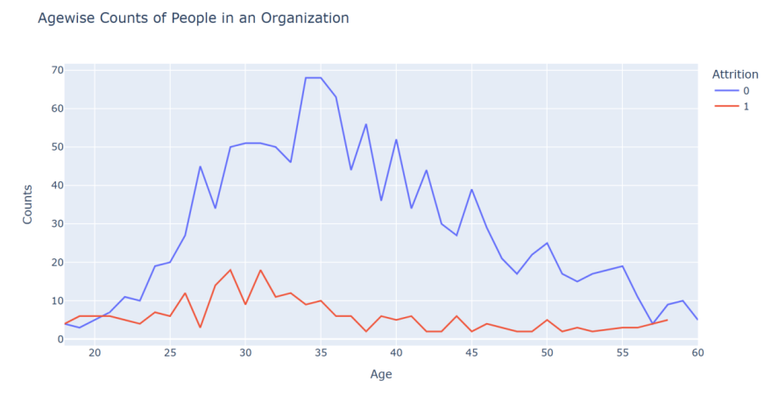
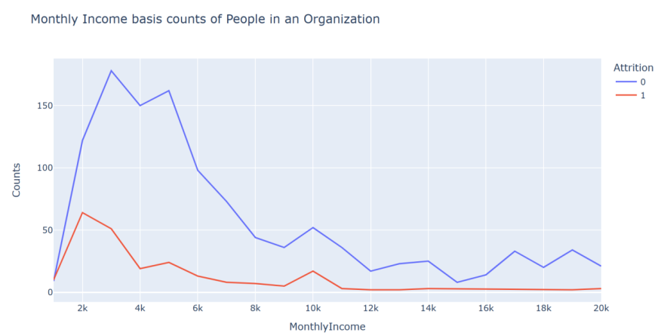
Exploratory Data Analysis
The attrition is maximum between the age groups 28-32. The attrition rate keeps on falling with increasing age, as people look after stability in their jobs at these point of times. Also at a very younger age, i.e. from 18-20, the chances of an employee leaving the organization is far more- since they are exploring at that point of time. It reaches a break even point at the age of 21
The attrition rate is evidently high at very low income levels- less than 5k monthly. This decreases further- but a minor spike is noticed around 10k- indicating the middle class liveliood. They tend to shift towards a better standard of living, and hence move to a different job. When the monthly income is pretty decent, the chances of an employee leaving the organization is low- as seen by the flat line

Slide 6
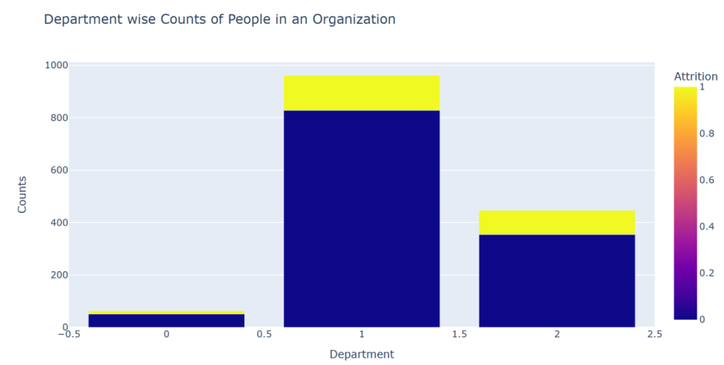
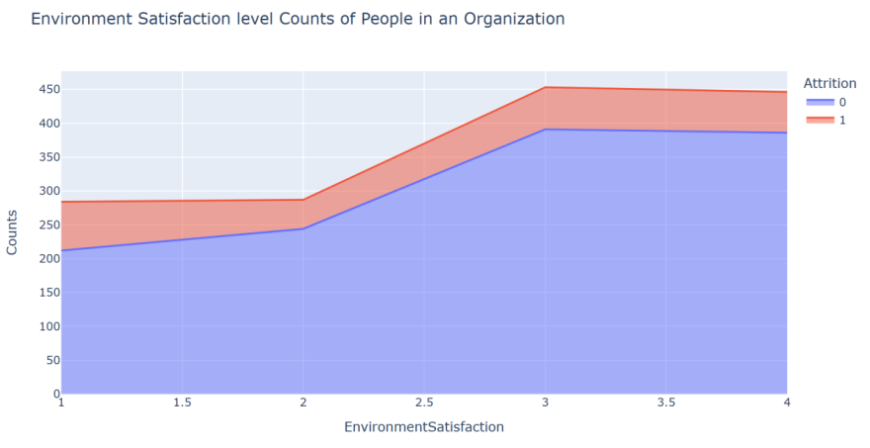
Exploratory Data Analysis
This data comprises of only 3 major departments- among which Sales department has the highest attrition rates (25.84%), followed by the Human Resource Department (19.05%). Research and Development has the least attrition rates, that suggests the stability and content of the department as can be seen from the chart above(13.83%).
In the satisfaction Level 1-2, the chances of people leaving the organization slightly decreases. This is indicative of the better hopes with which people stay in an organization. However, as we move from 2-3, people tend to move on to get better opportunities and experiences. The attrition rate is almost stagnant for the higher satisfaction levels

Slide 7
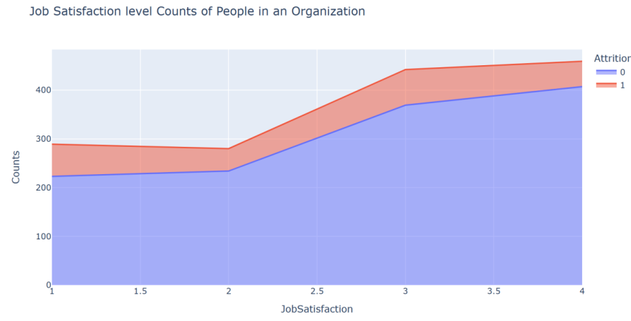
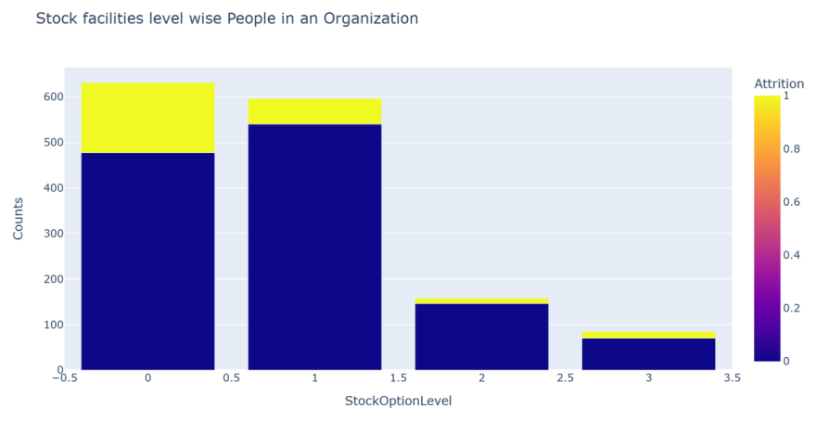
Exploratory Data Analysis
With an increasing job satisfaction, the attrition rates decrease as can be seen in the chart above. Also from range 1-2 range we can infer (as seen above in Environment Satisfaction), the attrition level falls, but raises from 2-3, where the people tend to choose better opportunities
The tendency of employees to leave the organization is much more when the stock availing options are limited. Since the stocks constitute to a huge amount of money while staying for a few years, people do not want to lose that opportunity. People with very limited/no stock options have a freedom to leave the organization at will.

Slide 8
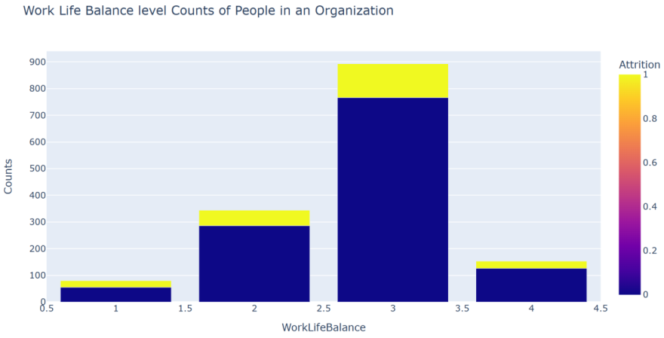
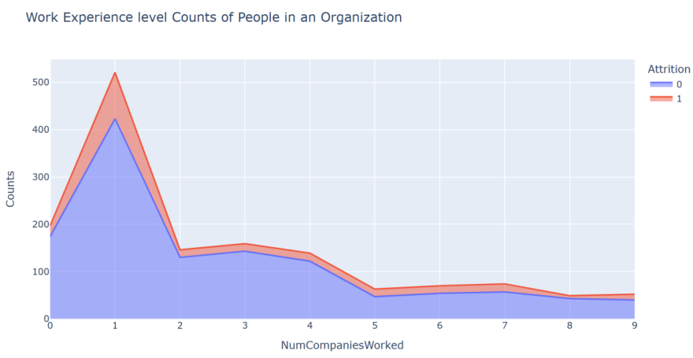
Exploratory Data Analysis
People with poor levels of Work life balance have adjusted themselves to their jobs, but as seen for the above parameters with a better work life score, people are more accustomed to the better life and want to go for an attrition more. But this trend perishes when the work life balance is really good, and people are satisfied with the work they are doing.
Employees who started their career with the company- or have switched to the company in the initial years of their career, have a higher chances of leaving the organization to a different company. People who have gained much experience- working in multiple companies tend to stay in the company they join.

Slide 9
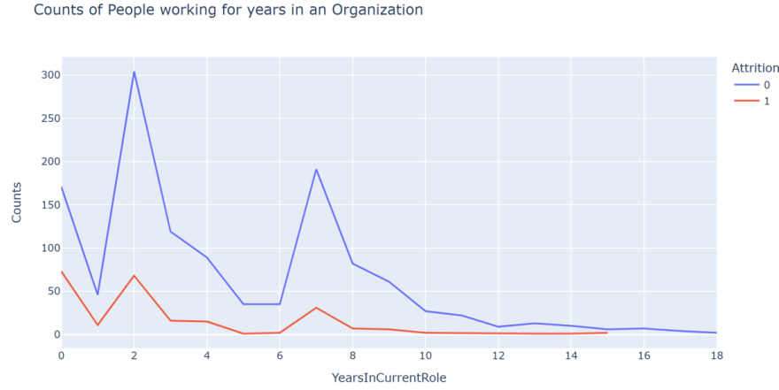
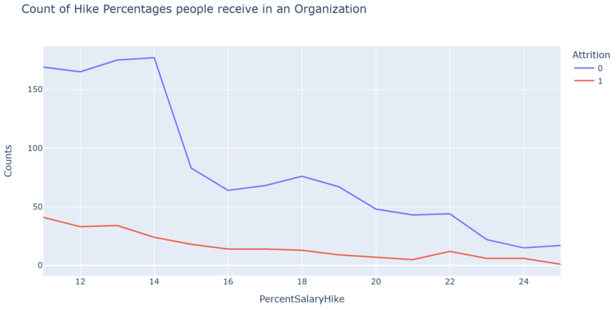
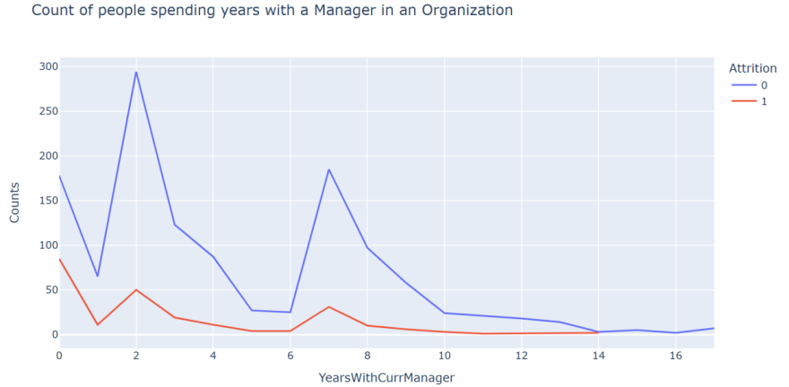
Exploratory Data Analysis

Slide 10
Exploratory Data Analysis
We have seen people are more prone to leave the organization in the starting years on their role. When people are in the same role for a long period of time, they tend to stay longer for moving in an upward role.
Higher hikes motivate people to work better, and stay in the organization. Hence we see the chances of an employee leaving the organization where the hike is lower, is much more than a company that gives a good hike.
We notice 3 major spikes in the attrition rate, when we are analyzing the relationship of an employee with their manager. At the very start, where the time spent with the manager is relatively less- people tend to leave their jobs- considering their relationship with their previous managers. At an average span of 2 years, when employees feel they need an improvement, they also tend to go for a change. When the time spent with the manager is slightly higher (about 7 years)- people tend to find their career progression stagnant, and tend to go for a change. But when the relative time spend with a manager is very high- people are satisfied with their work. Hence the chances of an employee resigning then is significantly low.

Slide 11
Summary Of Analysis
The workers with low `JobLevel`, `MonthlyIncome`, `YearAtCompany`, and `TotalWorkingYears` are more likely to quit their jobs.
- `BusinessTravel` : The workers who travel a lot are more likely to quit then other employees.
- `Department` : The worker in `Research & Development` are more likely to stay then the workers on other department.
- `EducationField` : The workers with `Human Resources` and `Technical Degree` are more likely to quit then employees from other fields of educations.
- `Gender` : The `Male` are more likely to quit.
- `JobRole` : The workers in `Laboratory Technician`, `Sales Representative`, and `Human Resources` are more likely to quit the workers in other positions.
- `MaritalStatus` : The workers who have `Single` marital status are more likely to quit the `Married`, and `Divorced`.
- `OverTime` : The workers who work more hours are likely to quit then others.

Slide 12
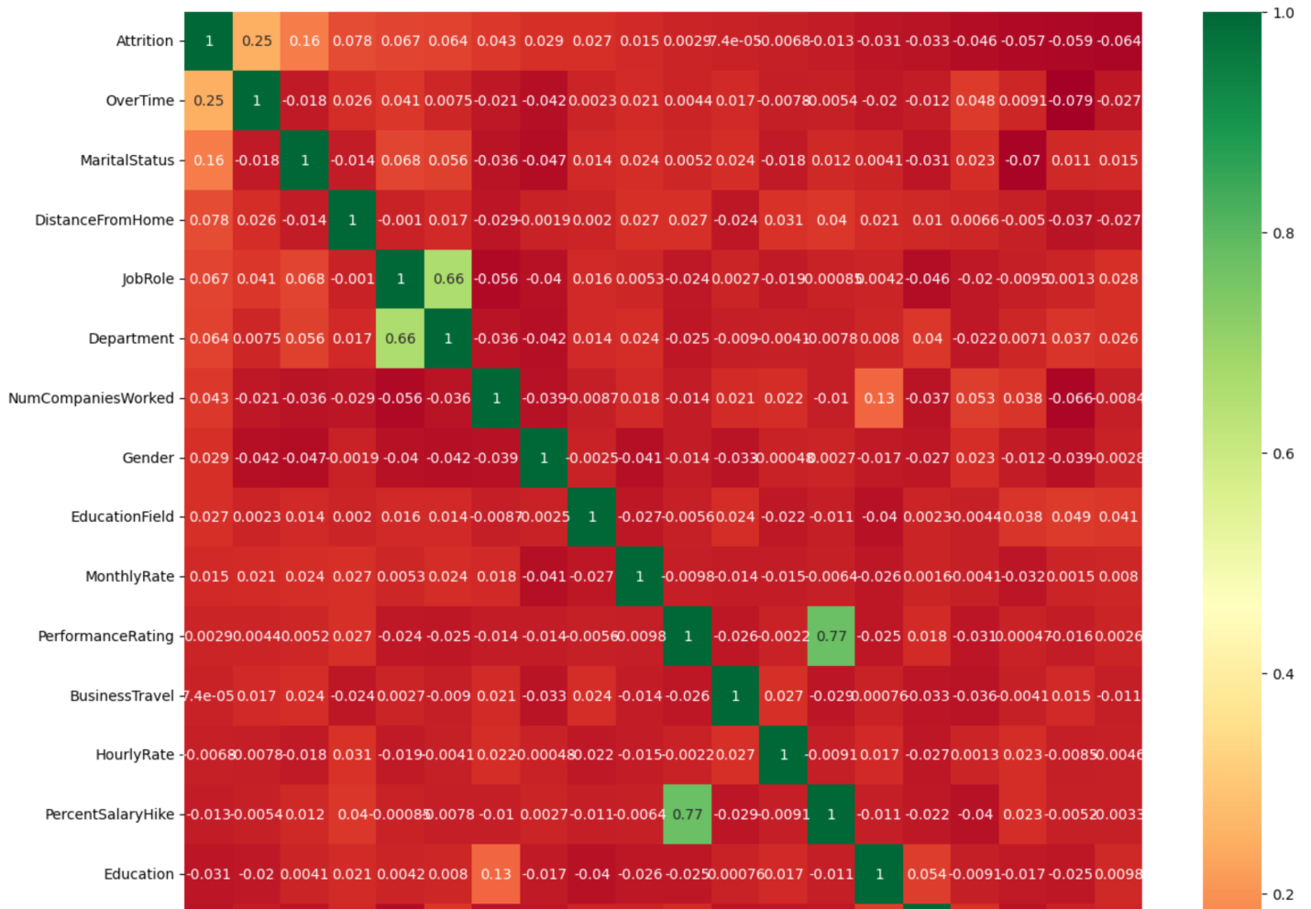
Correlation Matrix

Slide 13
Analysis of correlation results :
Monthly income is highly correlated with Job level.
Job level is highly correlated with total working hours.
Monthly income is highly correlated with total working hours.
Age is also positively correlated with the Total working hours.
Marital status and stock option level are negatively correlated

Slide 14
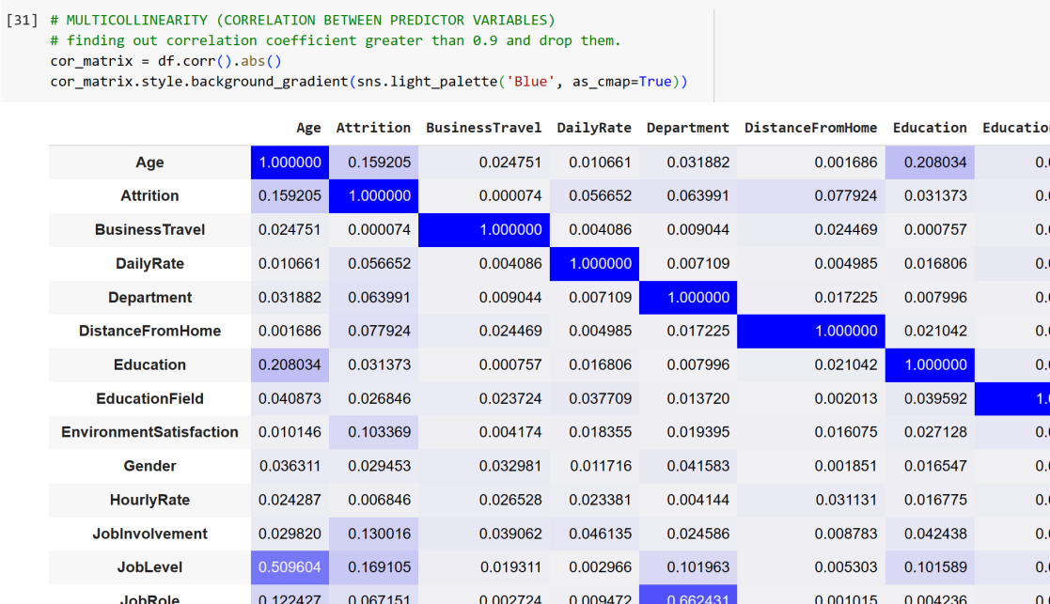
Multicollinearity
Found out columns whose correlation coefficient was greater than 0.9 and dropped them.
only 1 column was dropped.

Slide 15
Modelling Approach
The company which are bankrupted are very less compared to non bankrupt companies.
Employee Attrition - No: 83.6 % of whole data set
Employee Attrition - Yes: 16.4 % of whole data set
There is an imbalance in the dataset.
we need to use oversampling method to correct it.
Otherwise the model will be biased towards the majority class & would just predict every employee as not churned.
This is the main obstacle that we need to solve to obtain good performance.

Slide 16
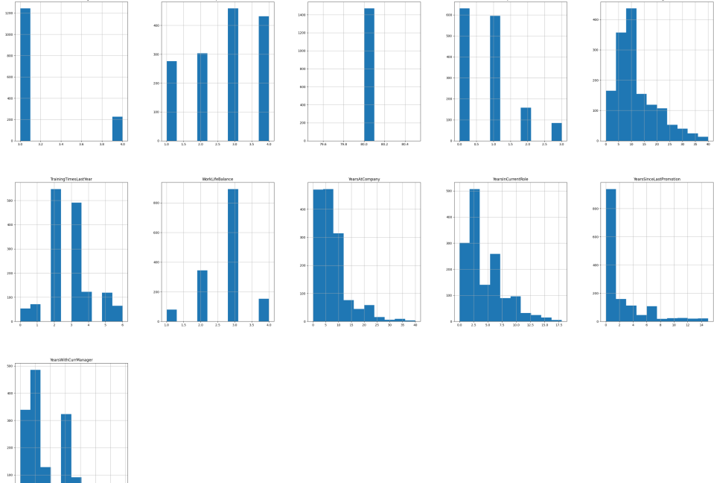
Skeweness in data
Most of the columns are skewed. This means many of the data points lie towards it's minimum or maximum.
This means model will not be able distinguish well between yes and no as most value lie towards one end.
Skewness greater than 1 is corrected by using log.
where as skewness less than -1 is corrected using cube.

Slide 17
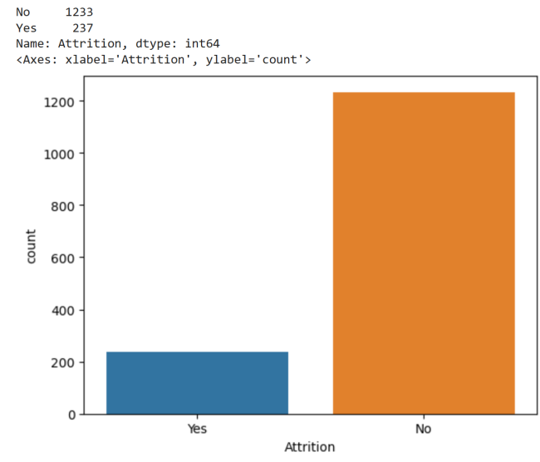
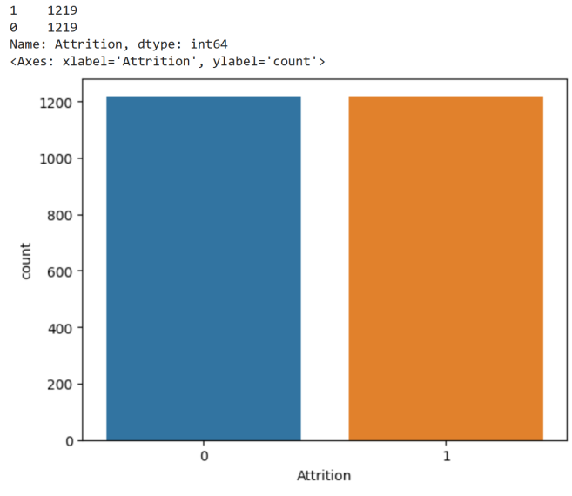
Oversampling the Target Feature

Slide 18
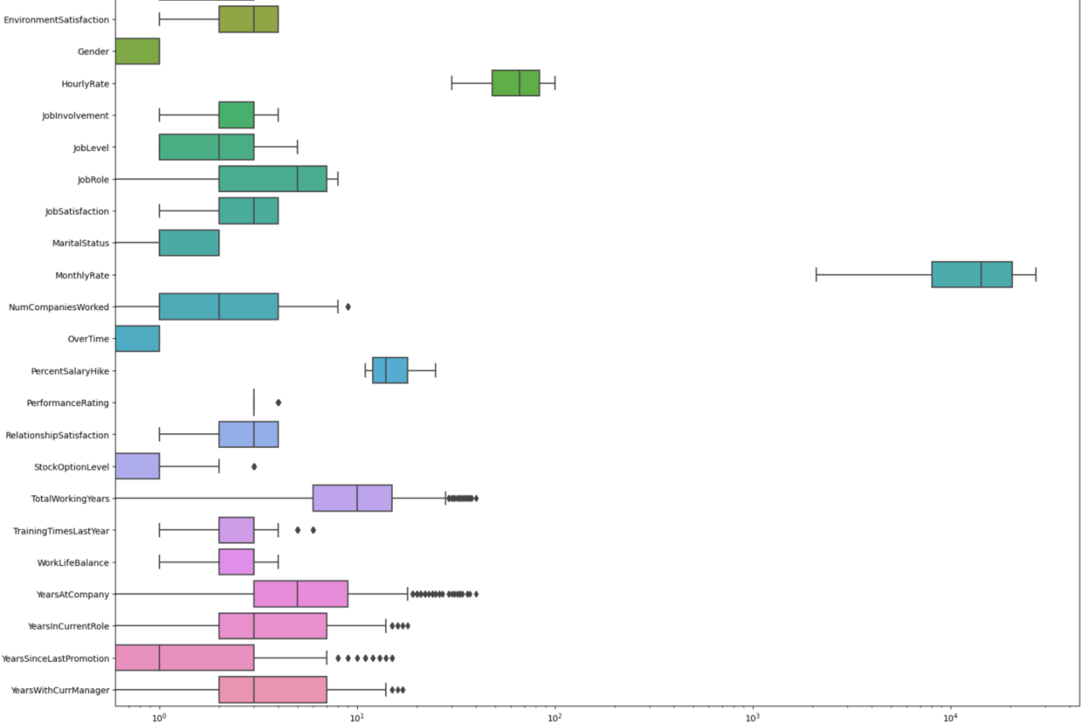
Outliers
There are multiple outliers in the dataset.
Removed the outliers from the dataset by calculating the IQR.

Slide 19
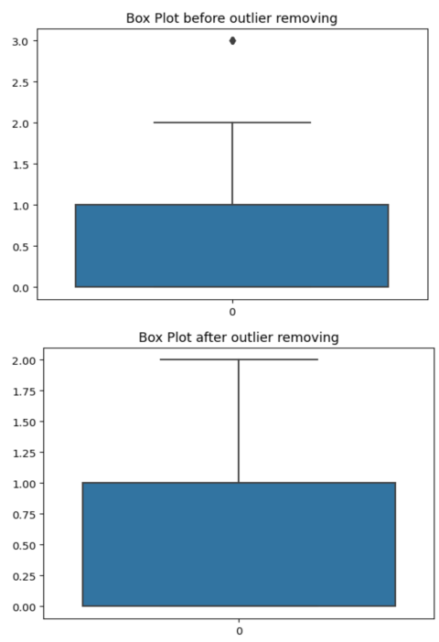
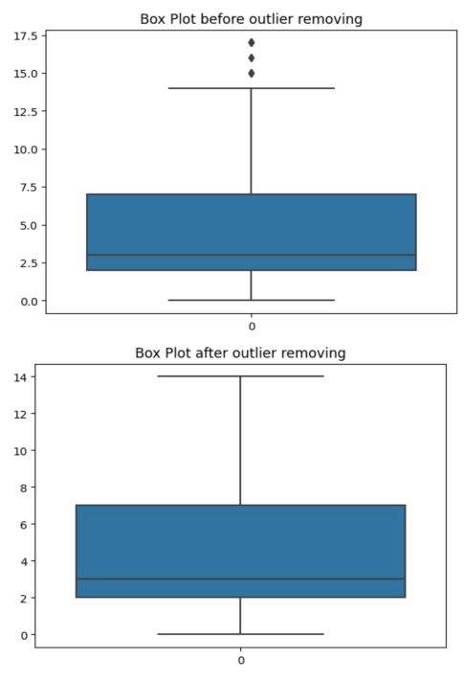
OULIERS REMOVAL
Removed the outliers from the data by calculating the IQR.

Slide 20
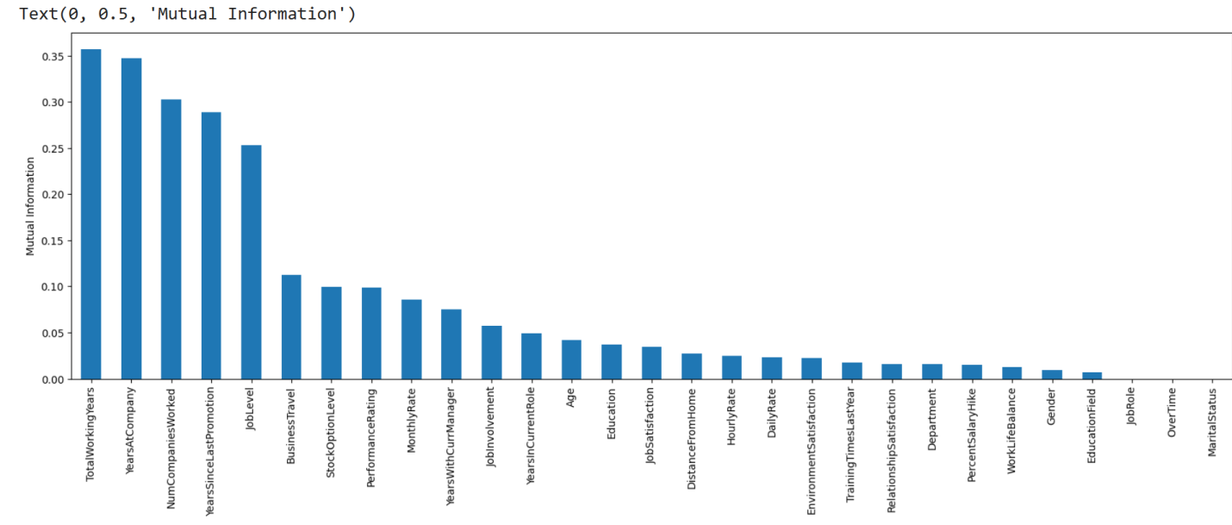
Feature Selection
Calculated the mutual information(mi) between the variables and the target the smaller the value of the mi, the less information we can infer from them.
Selected the top 25 independent Features out of 35 Features.

Slide 21
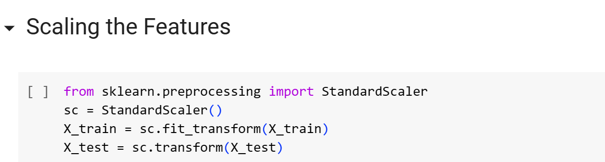
Modelling Approch
Splitting the dataset into training and testing sets (80% - 30%). We preserve the 30% testing set for the final evaluation.
Implemented 4 ML Model :
Logistic Regression
Random Forest
SVM
XGBoost

Slide 22
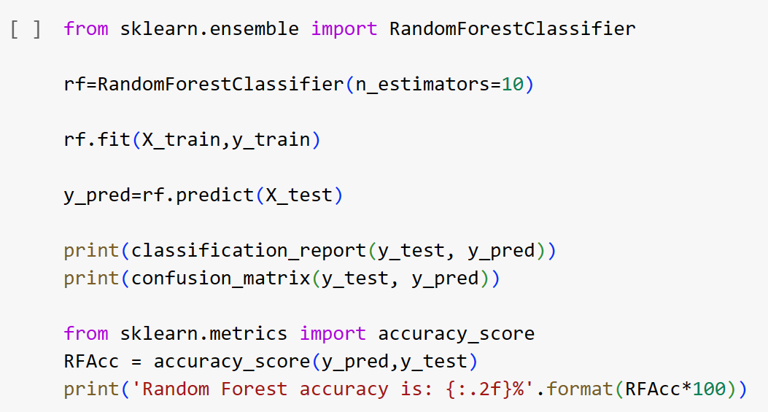
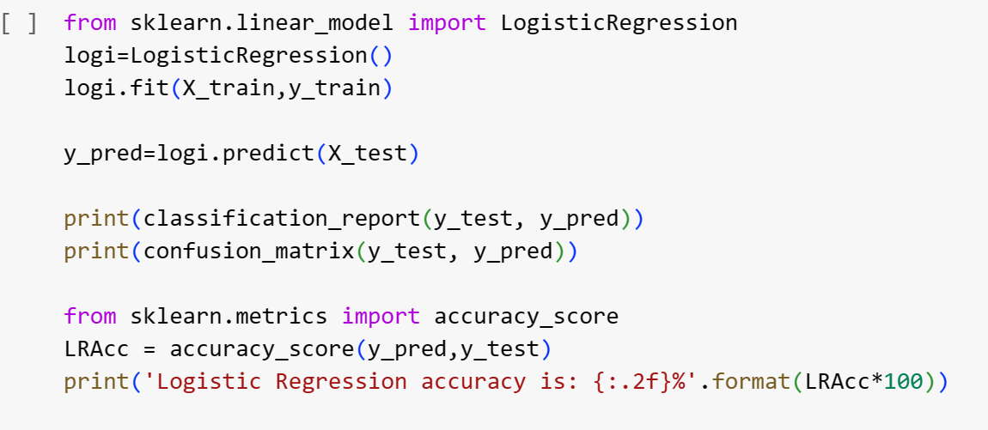
Machine Learning Models
Logistic Regression Model
Random Forest Model

Slide 23
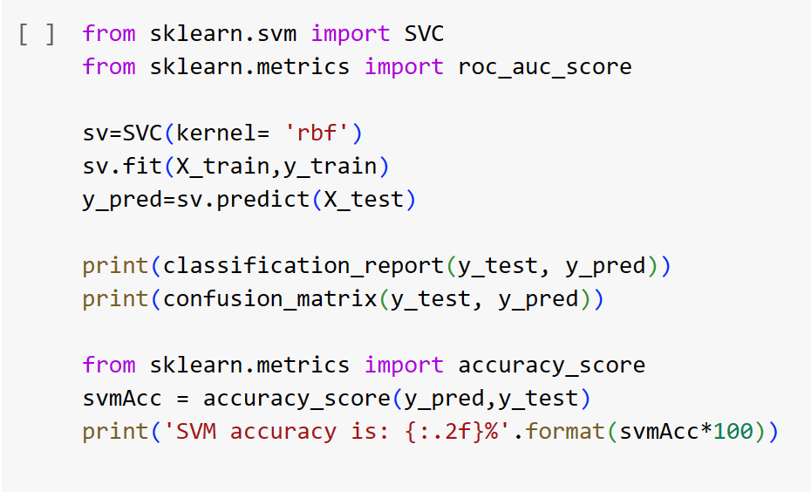
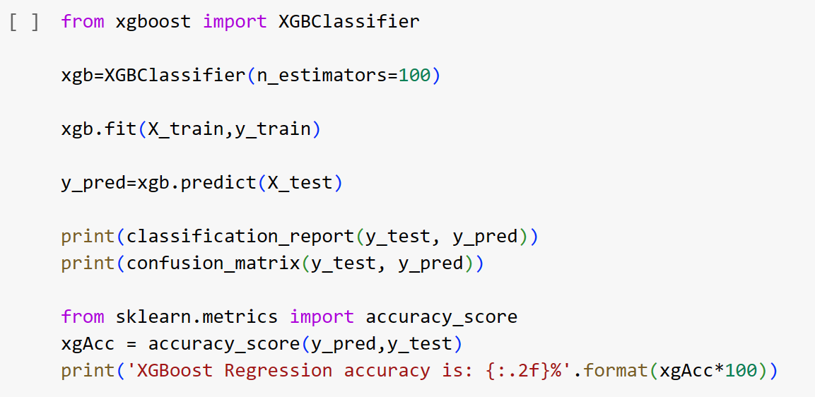
Machine Learning Models
SVM Model
XGBoost Model

Slide 24
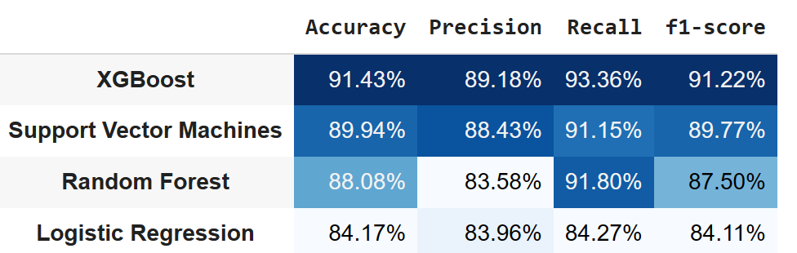
Comparing Different ML Models
Evaluation Metric
Top 3 performing baseline models are XGBoost, Random forest & SVM.
The best performing model is XGBoost by considering the F1 score, Precision which is an ideal metric to choose because in this problem, it is important to predict the positive class with very high accuracy even if we are not able to predict the negative class.
To understand and compare model performances, accuracy is not a good choice of metrics here as this data is imbalanced. So I will be using Precision, F1 Score for evaluation.

Slide 25
Conclusion
People are tending to switch to a different jobs at the start of their careers, or at the earlier parts of it. Once they have settled with a family or have found stability in their jobs, they tend to stay long in the same organization- only going for vertical movements in the same organization.
Salary and stock options have a great motivation on the employees and people tend to leave the organization much lesser. Higher pay and more stock options have seen more employees remain loyal to their company.
Work life balance is a great motivation factor for the employees. However, people with a good work-life balance, tend to switch in search of better opportunities and a better standard of living.
Departments where target meeting performance is very much crucial (for e.g. Sales) tend to have a greater chances of leaving the organization as compared to departments with more administration perspective (For e.g. Human Resources)
People with a good Job Satisfaction and Environment satisfaction are loyal to the organization- and this speaks loud for any Organization. However, people who are not much satisfied with their current project- tend to leave the organization far more.

Slide 26
Conclusion
Top Reasons why Employees leave the Organization:
No Overtime: This was a surprise, employees who don't have overtime are most likely to leave the organization. This could be that employees would like to have a higher amount of income or employees could feel that they are underused.
Monthly Income: As expected, Income is a huge factor as why employees leave the organization in search for a better salary.
Age: This could also be expected, since people who are aiming to retire will leave the organization.
Knowing the most likely reasons why employees leave the organization, can help the organization take action and reduce the level of Attrition inside the organization.

Slide 27
Future Scope
The data is not very extended. Only 3 departments have been presented. It would be better to have some more departments and some information regarding other organizations to study the pattern more distinctly.
This model might be beneficial as the results will lead companies to predict their employees' churn status and consequently help them to reduce their human resource costs.

Slide 28
References
R. Shiva Shankar, V. Priyadarshini, P. Neelima, CH. Raminaidu, "Analyzing Attrition and Performance of an Employee using Machine Learning Techniques", 2021 5th International Conference on Electronics, Communication and Aerospace Technology (ICECA), pp.1601-1608, 2021.
Thee Juvitayapun, "Employee Turnover Prediction: The impact of employee event features on interpretable machine learning methods", 2021 13th International Conference on Knowledge and Smart Technology (KST), pp.181-185, 2021.
Vengai Musanga, Edmore Tarambiwa, Kudakwashe Zvarevashe, "A Supervised Machine Learning Model to Optimize Human Resources Analytics for Employee Churn Prediction", 2022 1st Zimbabwe Conference of Information and Communication Technologies (ZCICT), pp.1-6, 2022.
Thee Juvitayapun, "Employee Turnover Prediction: The impact of employee event features on interpretable machine learning methods", 2021 13th International Conference on Knowledge and Smart Technology (KST), pp.181-185, 2021.

